Slide 1
Smart drone in health applications
made by
Saad Bakheet Alsharif 1408300
Supervisor: Dr .Vijey Thayananthan

Slide 2
Aims of the project:
In this project, using smart functions of the drone in healthcare application is the main aim. Smart functions depend on the use of drone simulator and AI algorithms which allow me to identify the accuracy of the path. The drone will go to its destination with the first aid or medication by taking shortest path using GPS tracking.

Slide 3
Problem definition:
They are some people who live in remote villages need some medications, or people need first aid. It is required for supplying urgent medical facilities quickly before the ambulances reach the location through the heavy traffic road or crowded places. During the difficult situations such as problems of finding delivery staff, drones can be used for delivering services which are fast and safe to transport the medical packages.

Slide 4
Project scope:
Use a simulator drone and AI shortest path algorithms to deliveries package to the exact destination are the scopes of this project. All these points mentioned in the scope shall be integrated together using a drone kit environment. To deliver the medical package, a drone is expected to work smoothly under the perfect environmental conditions.

Slide 5
Expected outcome
A drone program that calculates the implementation of a short path algorithm in maps to find (short path).

Slide 6
Target User:
The targeted users are hospital looking for transport medicine and possibly educational institution looking to send first aid.

Slide 7
The Suggested Solution:
Give the Destination.
Calculate distance from algorithm
Start to fly through the path you’re taken by the algorithm.
Deliver the package safely.
Build a database of the path to store the Gps tracing.
Related to CS: the project works in the “artificial intelligence” area because a drone Simulator will be used. It also falls in the “AI short path algorithm” area because it uses algorithms to Guidance the drone to Destination.

Slide 8
Functional Requirements
Simulation requirements of drone kit
Identify Destination
Calculate the path using AI algorithm
Save the path database

Slide 9
Non-functional Requirements
The efficiency of drone.
Accuracy of Destination.
Stability on the path.
Reliability.

Slide 10
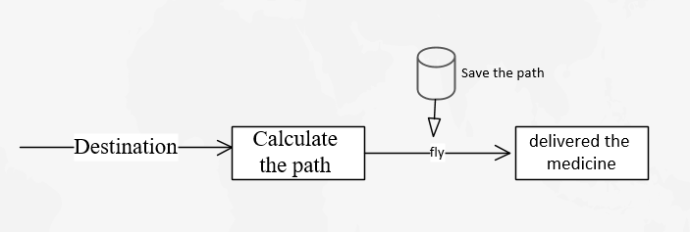
Data Requirements

Slide 11
Software :-
Drone kit simulator.
Linux os.
Python.
Qground control (ground station) .

Slide 12
Methods and Approaches

Slide 13
Planning
I planned for the project by work break down structure (WBS) then scheduled the project by Gantt Chart & time estimates to manage & organize work to complete the project.

Slide 14
Analysis
I started to read about the problem from the research papers and books which teach me about drone and how to program it.
Then, We defined the project scope, functional requirements , non-functional requirements and the expected outcome.
Then I attended a tutorial on the construction of drone and programmed it in Riyadh.

Slide 15
Design
I designed an initial design for the project, flowchart.

Slide 16
Implementation
In my project, I have considered implementing following parts:
Necessary solutions using a simulator (practice how to give the command throw Linux OS.)
Write the algorithm in the script in python.
Define location using GPS.
Find the path using an algorithm.
Show the result of the algorithm in the ground station

Slide 17
Maintenance
After completing the code , will test the program in order to remove the errors.

Slide 18
Activities and Actions

Slide 19
Flowchart
This flow chart explains how the system will work.

Slide 20
Completed:
Practice on Simulator and how to give the command throw Linux OS.
Write the algorithm in the script in python.
Find the path using an algorithm.
Show the result of the algorithm in the ground station

Slide 21
Not Completed :
Obstacles of location using GPS in real map.

Slide 22
Implementation

Slide 23
Tools & technologies
Software:-
Drone kit simulator.
Linux OS.
Python.
Qground control (ground station).
Microsoft Visio (To design the project).

Slide 24
Tools & technologies
A* algorithm
Selected algorithm (A* algorithm) is one of the artificial intelligence (AI) procedures for finding paths. Comparing other AI algorithms, it solves the problems of path finding quickly and efficiently. It calculates the shortest path by searching among all possible paths to the solution (goal) for the one that incurs the smallest cost (least distance traveled, shortest time, etc.), and among these paths, it first considers the ones that appear to lead most quickly to the solution. It is formulated regarding weighted graphs: starting from a specific node of a graph, it constructs a tree of paths starting from that node, expanding paths one step at a time, until one of its paths ends at the predetermined goal node.

Slide 25
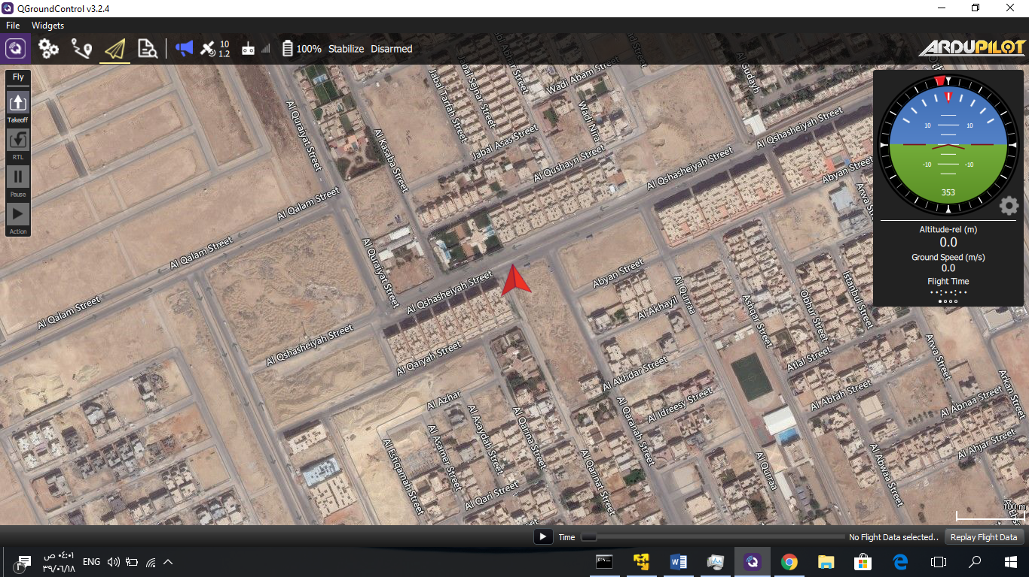
Interface
Here The user can see the path of the drone simulator ( ground station ).

Slide 26
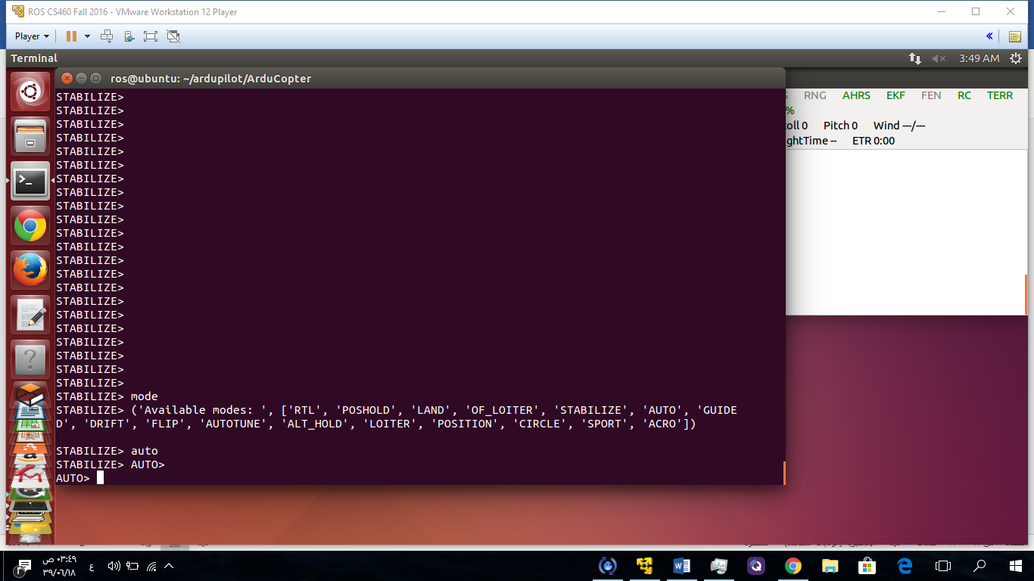
Interface
Here The user can enter command to the drone throw mavlink protocol

Slide 27
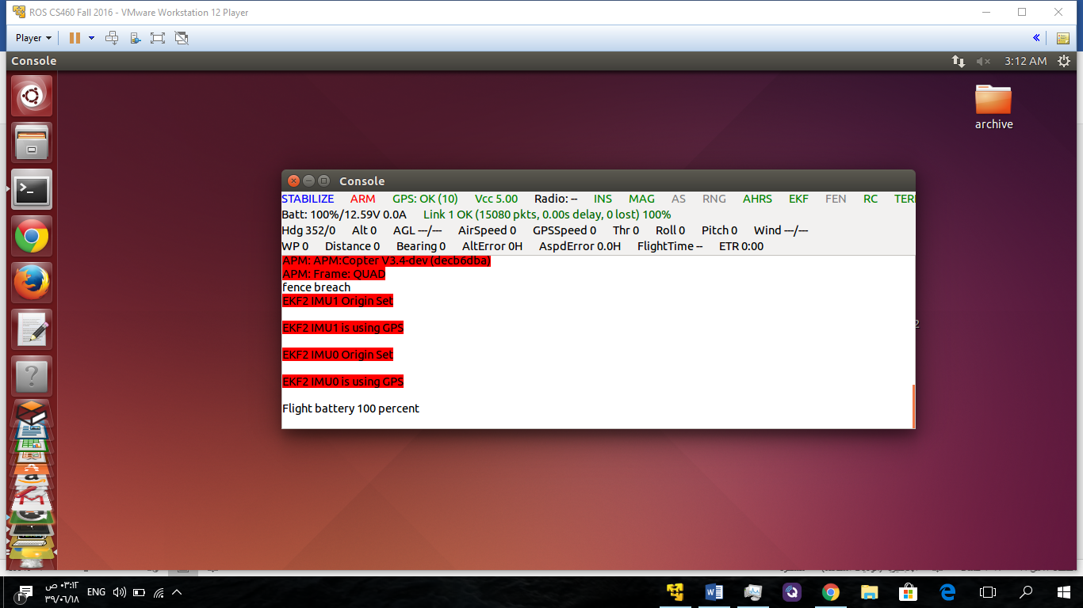
Interface
Here we can see the information about the drone simulator :

Slide 28
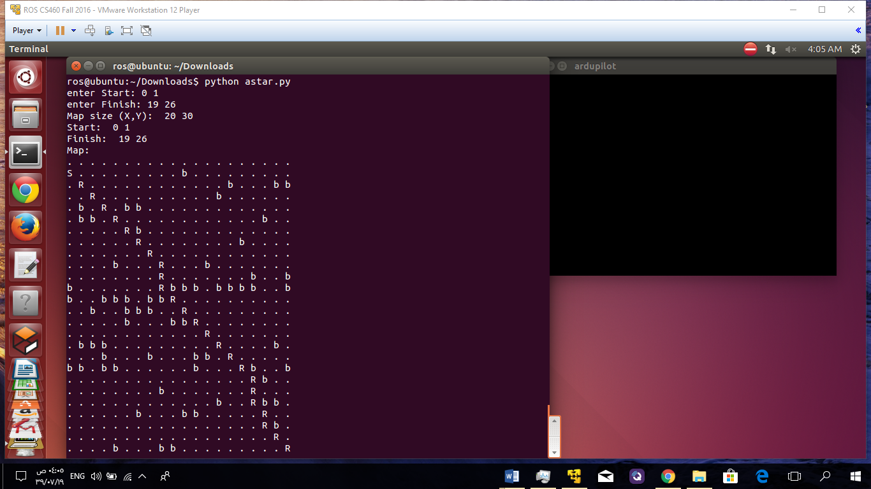
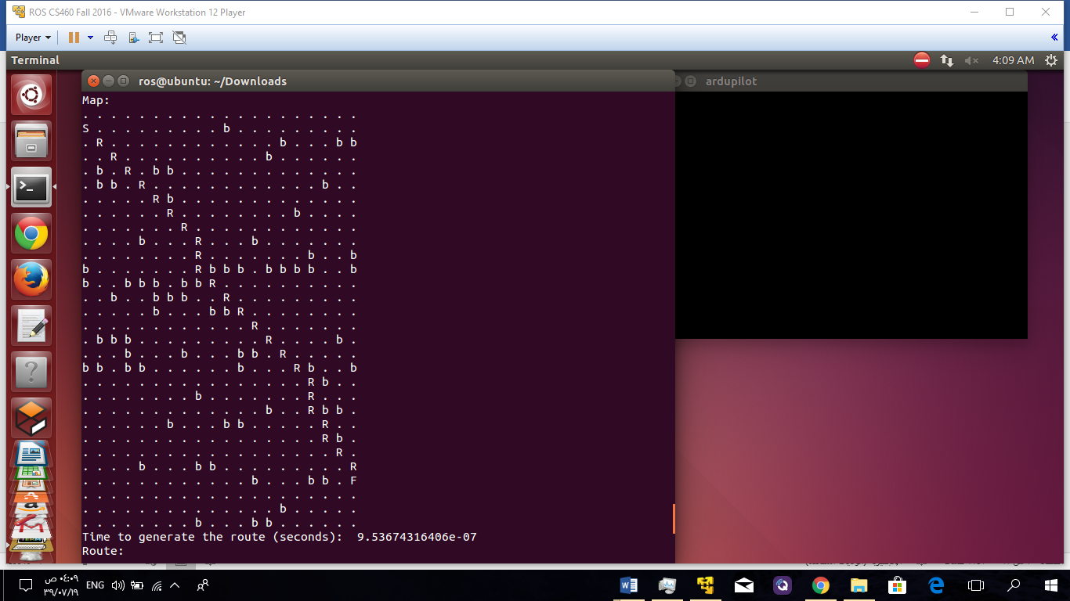
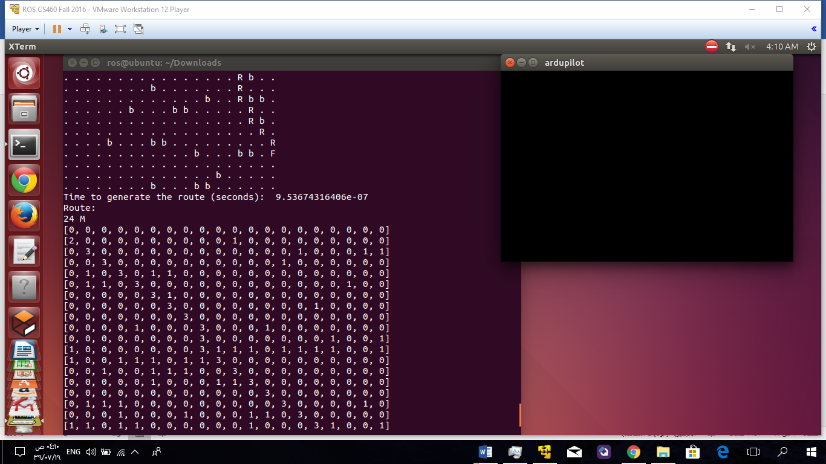
Interface
Here the script of algorithm applying on a grid map

Slide 29
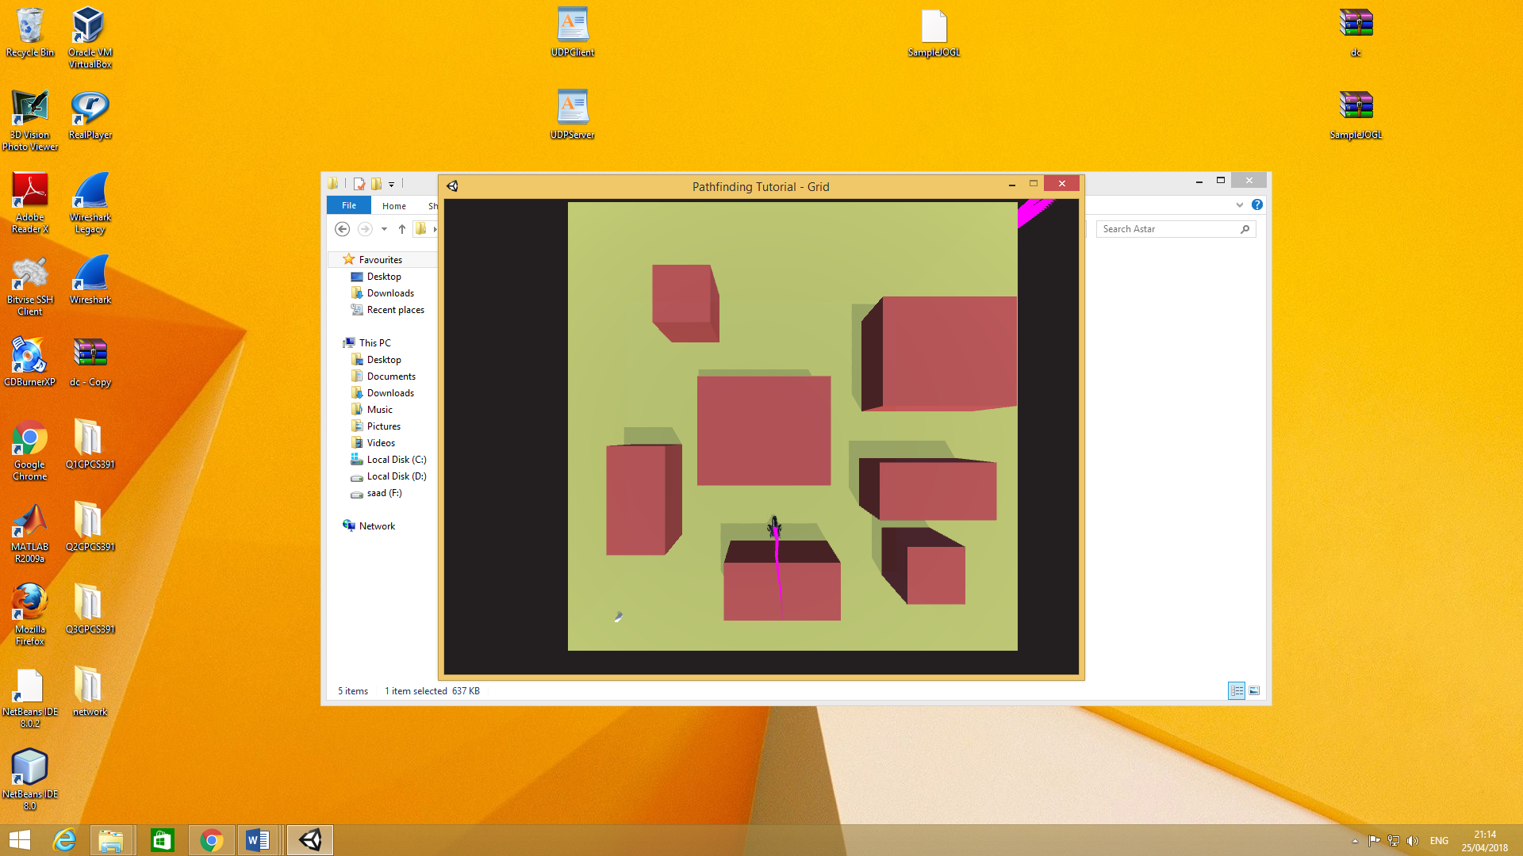
Interface
Here the script of algorithm applying on a unity map

Slide 30
Testing
Here, I have done the unit test in order to test many situations of the system to check the correctness of the results. I check the correctness of the results by comparing the results accuracy of the algorithm
The test cases:
Location

Slide 31
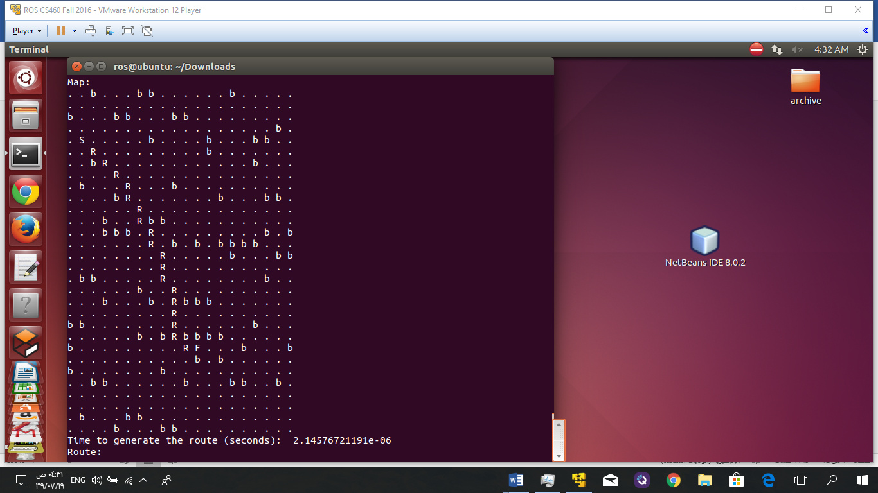
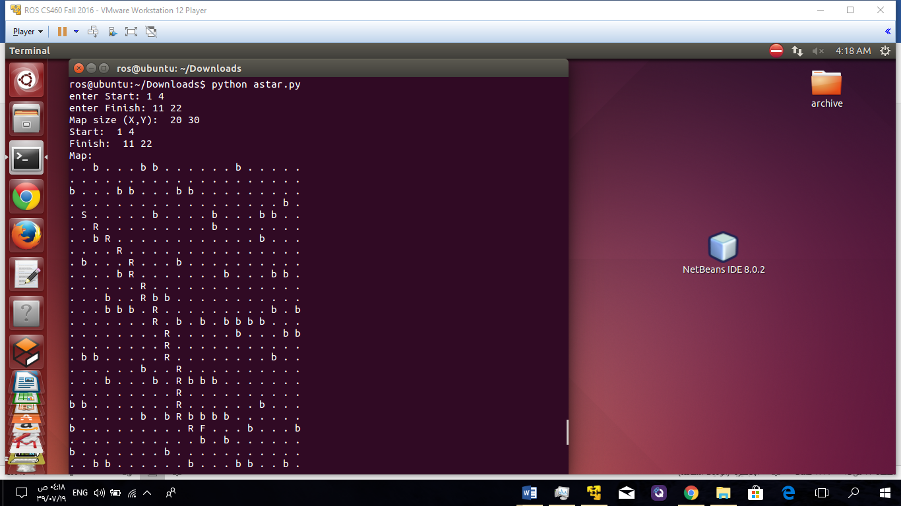
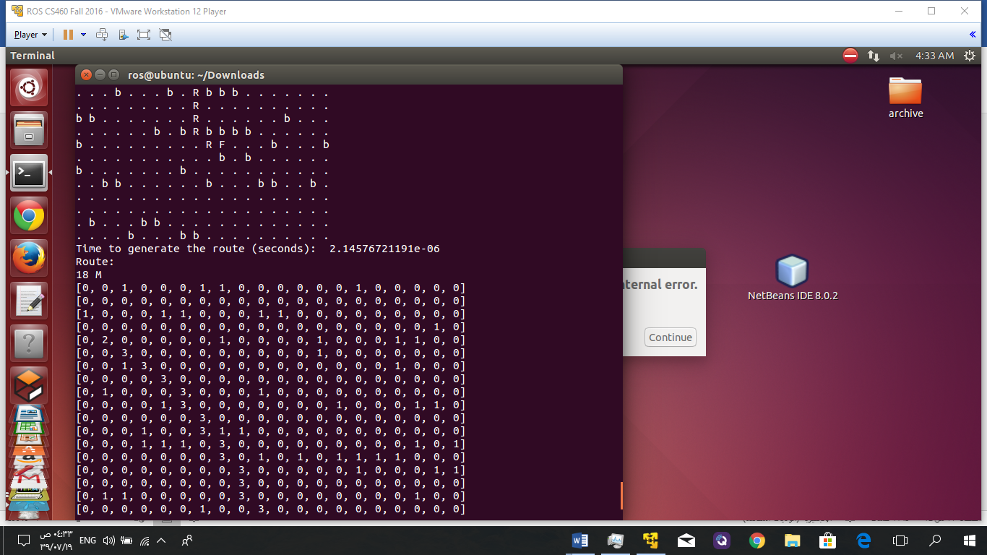
First case:

Slide 32
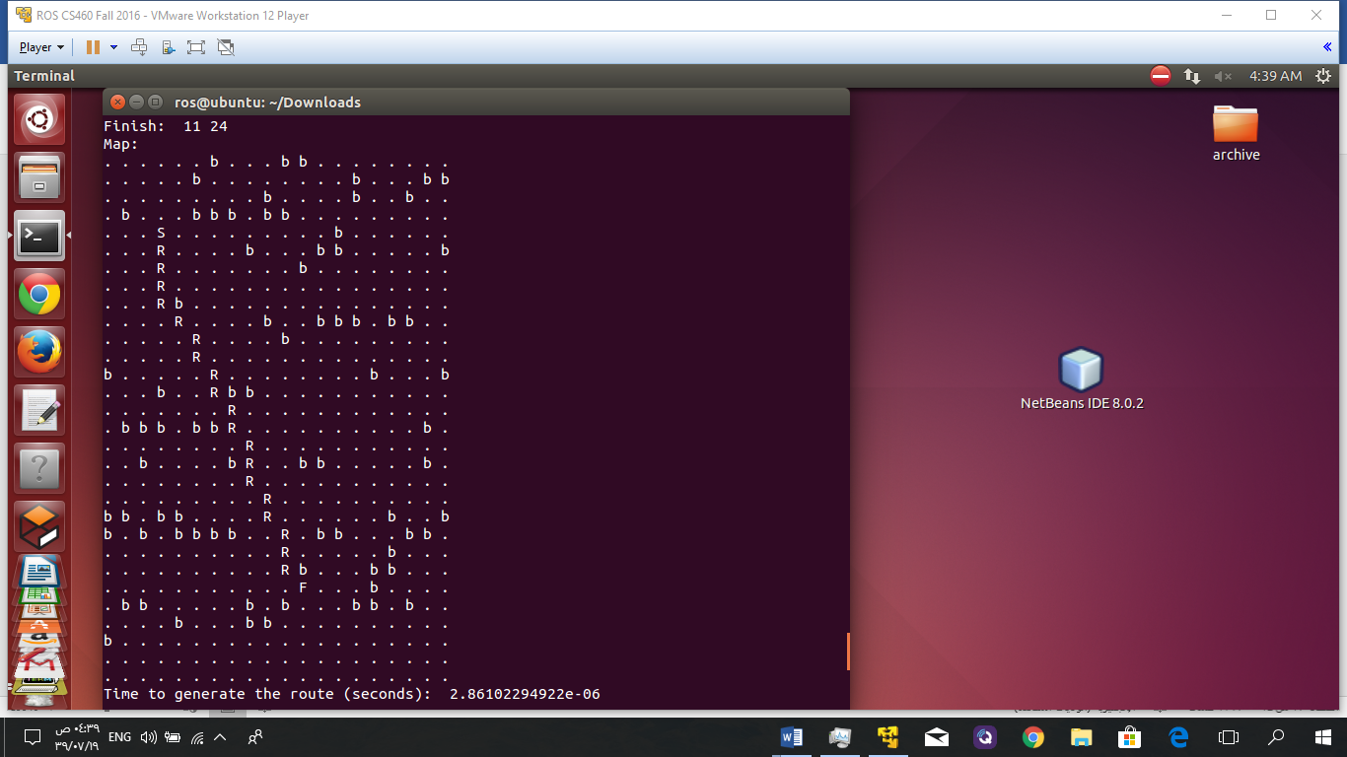
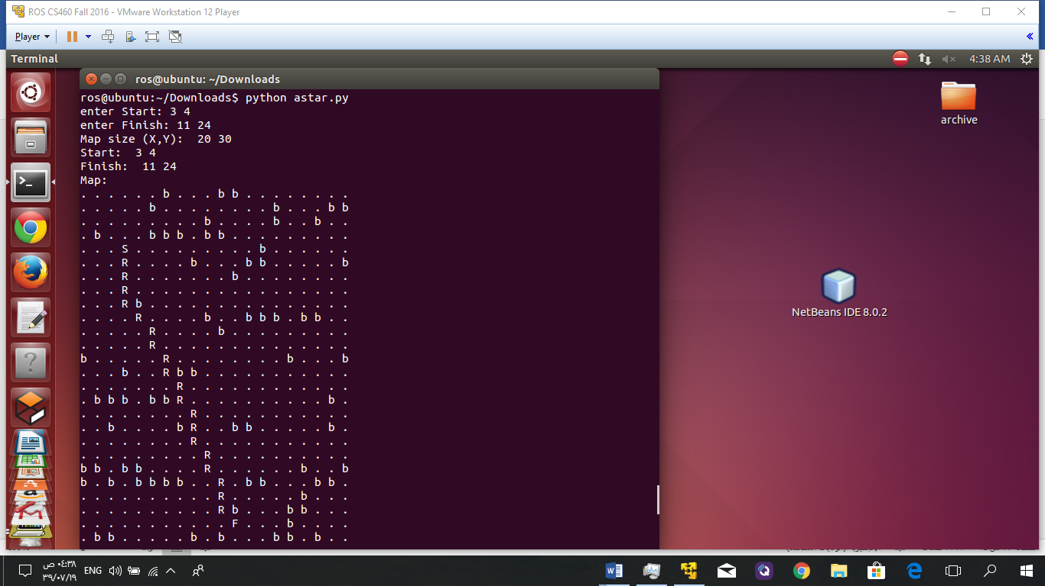
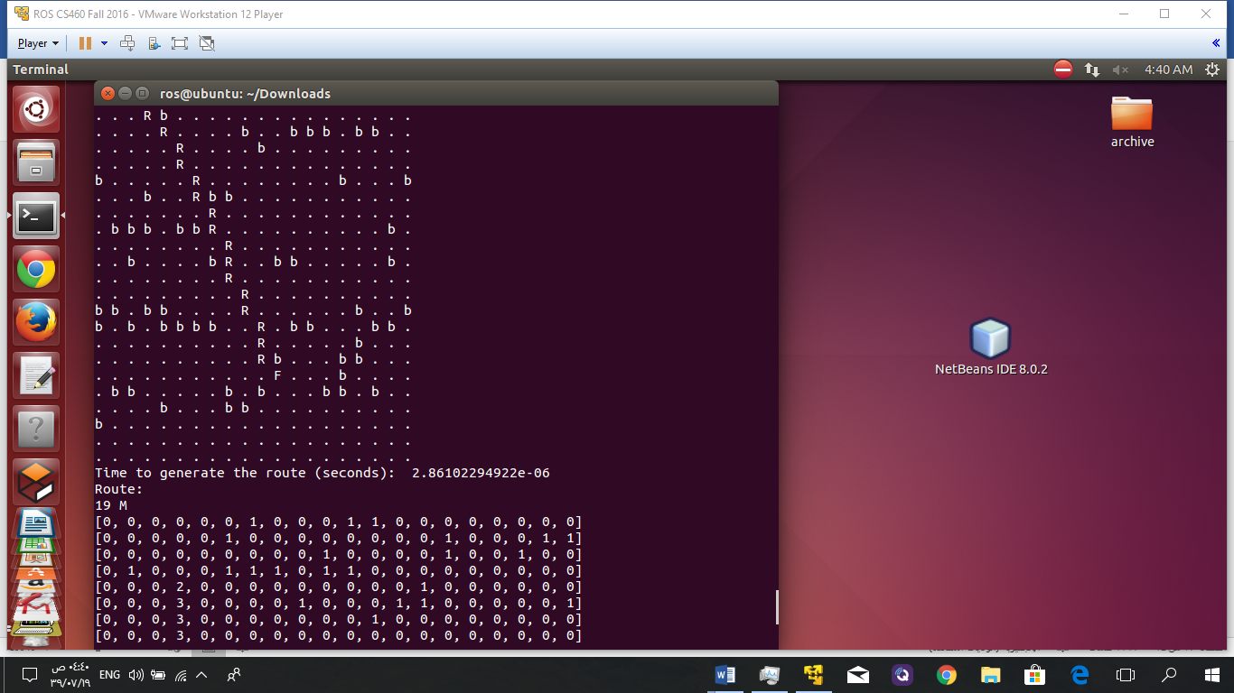
Second case:

Slide 33
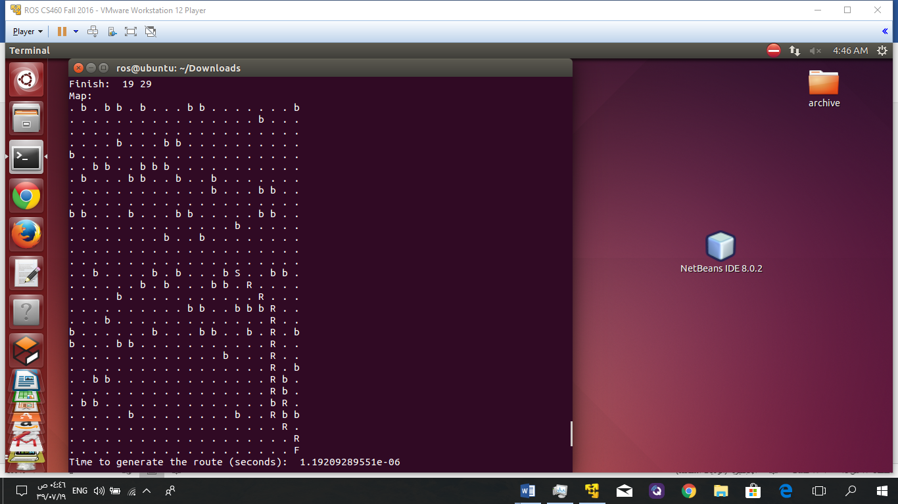
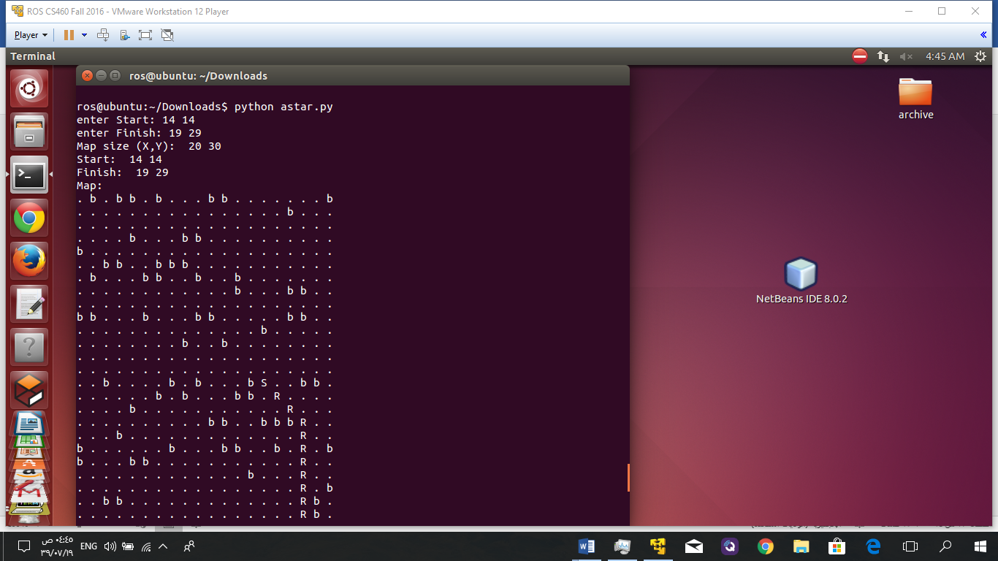
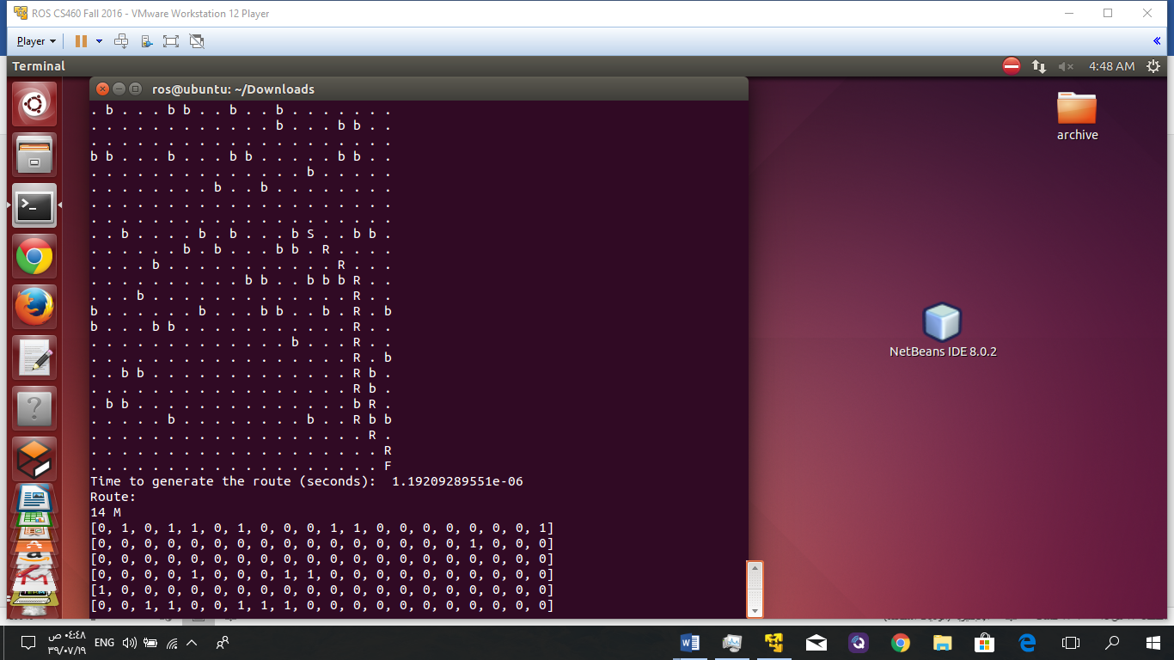
Third case:

Slide 34
Conclusion for the testing phase
The results were good ,reasonable and as expected. So the system works perfectly. Further, we will try to improve it using real maps as a future work.

Slide 35
REFERENCES :
[1] Brito, V., Brito Palma, L. F. F., Vieira Coito, F., &amp; Valtchev, S. (2016). Modeling a Supervisory Control of a Virtual X8-VB Quadcopter. In 17th International Conference on Power Electronics and Motion Control (p. 8). Varna, Bulgária.
[2] DroneKit-Python 2.x helps you create powerful apps for drone http://python.dronekit.io/
[3] is an advanced open-source autopilot system for multicopters, helicopters, and other rotor vehicles.It offers a wide variety of flight modes from fully manual to fully autonomous. http://ardupilot.org/copter/

